Slide 1
TRENDS IN NORTH WEST EUROPE
Trends in europe| Frits Herlaar| 3-2-2013

Slide 2
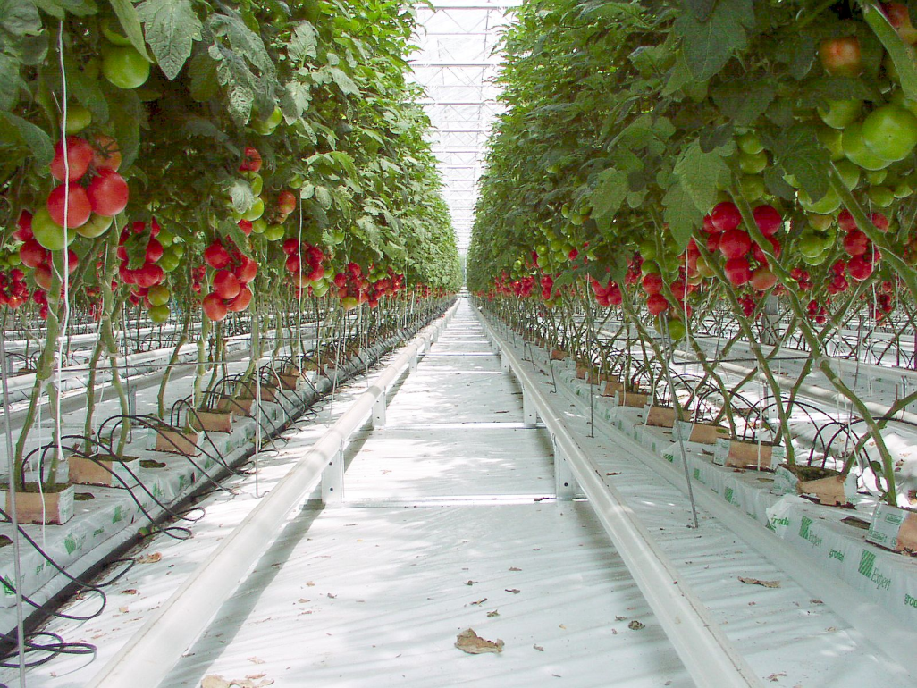
Heated greenhouse
Growing areas
The Netherlands
Belgium
France
Poland
Russia
Scandinavia
United Kingdom
Title of the presentation | Name Speaker | Date

Slide 3
Trends Heated greenhouse
Landscape
Economic crisis
Stable acreage NW Europe, slight growth E. Europe, decrease in number of growers
Price level of product under pressure
Increase productivity
Cost management
Labor
Energy
Title of the presentation | Name Speaker | Date

Slide 4
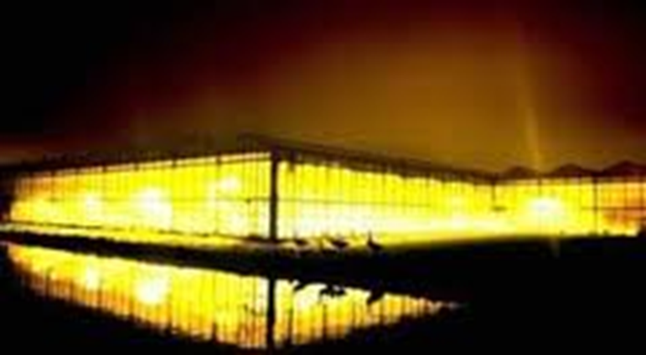
Trends Heated greenhouse
Tomato Growing
Many types of tomatoes; TOV, beef, small beef, cocktail, plum, mini plum, grape, cherry, oxheart,…….
Year round growing
High tech production, artificial lighting in greenhouse
High production
High quality
Taste
Rootstocks
Demand for high quality seeds
Title of the presentation | Name Speaker | Date

Slide 5
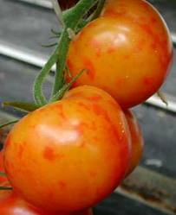
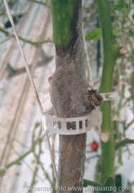
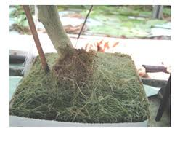
Trends Heated greenhouse
Diseases
Botrytis
Pepino Mosaic Virus
Crazy roots – Agrobacterium
Oidium
Fulvia fulvum
Title of the presentation | Name Speaker | Date

